Slide 1
Introduction to Processor Architecture (EC2.204)
Lecture 1 - Introduction to computer systems
Deepak Gangadharan
Computer Systems Group (CSG), IIIT Hyderabad
Slide Contents: Based on materials from text books and other public sources

Slide 2
Course Outline
Instruction Set Architecture
Processor Architecture and Design
Memory Hierarchy
Virtual Memory
OS System Calls and Processes (Optional – based on time left)

Slide 3
Reference Books
Text book
Auxiliary reference books

Slide 4
Administrivia
Grade Distribution (Tentative)
Quiz: 10%, Exam: 40%, Project: 50% (1 quiz, 1 final exam, 1 Project)
Participation: ~5%
Teaching Assistants
Kethu Sesha Sarath Reddy - kethu.sesha@students.iiit.ac.in Sannidhya Gupta - sannidhya.gupta@research.iiit.ac.in K Pavan Kumar - pavan.kondooru@research.iiit.ac.in Ajit S - ajit.srikanth@research.iiit.ac.in N Mahen - mahen.n@research.iiit.ac.in

Slide 5
Expected Conduct
Please be active and ask questions – Participation marks!
Plagiarism will be penalized severely! The projects have been scrutinized strictly in the last semesters.
Submission times are strict! Delays allowed only for genuine medical reasons.

Slide 6
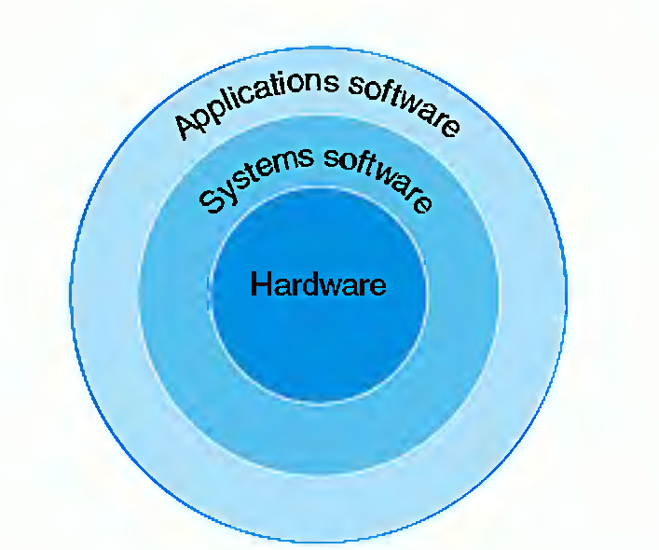
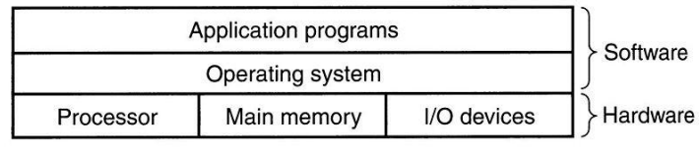
Computer System = Hardware + System Software + Application Software
Source: H&P-3 (Hennesy & Patterson, 3rd Edition)
System Software: Operating System, Device Drivers, Loaders, Linkers, Compilers, Assemblers, …. Application Software: Web browsers, user-specific applications, …..

Slide 7
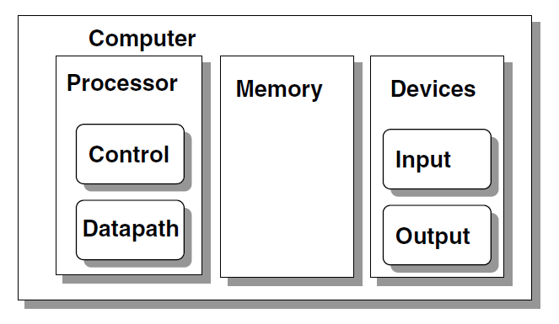
Major Function Units
Source: Prof. Cheung’s Course Notes (Imperial College, London)

Slide 8
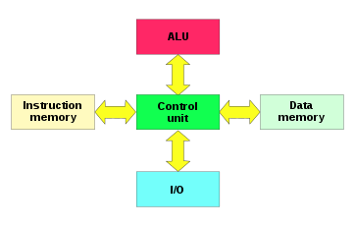
Computer Architecture - Models
Von Neumann Architecture
Harvard Architecture
Source: Wikipedia

Slide 9
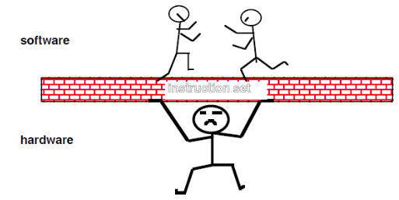
ISA: Hardware – Software Interface

Slide 10
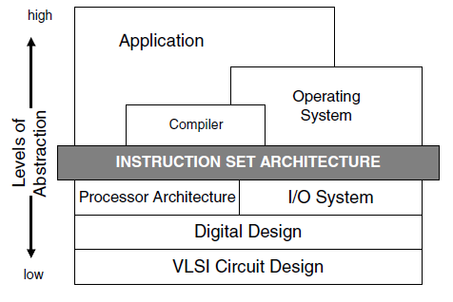
Instruction Set Architecture (ISA)
ISA is an abstraction for the Software to interface with the Hardware.
Advantage: Multiple implementations for the same ISA.
Example: AMD Opteron 64 and Intel Pentium 4 are different Implementations of the ISA.
“. . . the attributes of a [computing] system as seen by the programmer, i.e. the conceptual structure and functional behavior, as distinct from the organization of the data flows and controls the logic design, and the physical implementation.”
Amdahl, Blaaw, and Brooks, 1964

Slide 11
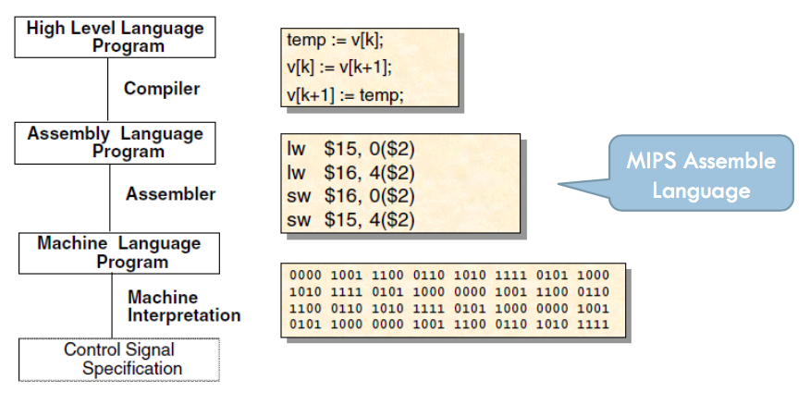
ISA: Hardware – Software Interface

Slide 12
Programming Abstractions
We can program a microprocessor using
Instruction opcodes (also called Machine Code)
Assembly language
High level programming languages
The level of abstraction increases from Top to Bottom.
As the level of abstraction increases, ease of programmability also increases!
But we may lose the fine-grained control over the underlying hardware?

Slide 13
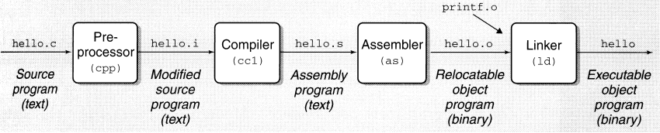
ISA: Hardware – Software Interface
gcc -o hello hello.c
Source: Bryant & O’Hallaron

Slide 14
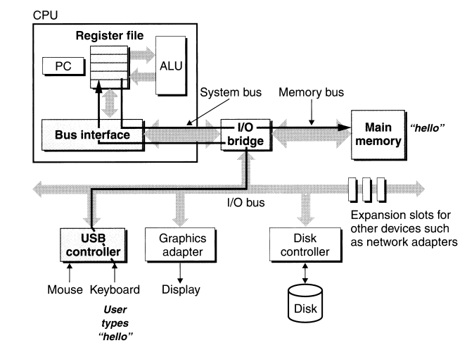
Running the “Hello World” Program
Source: Bryant & O’Hallaron

Slide 15
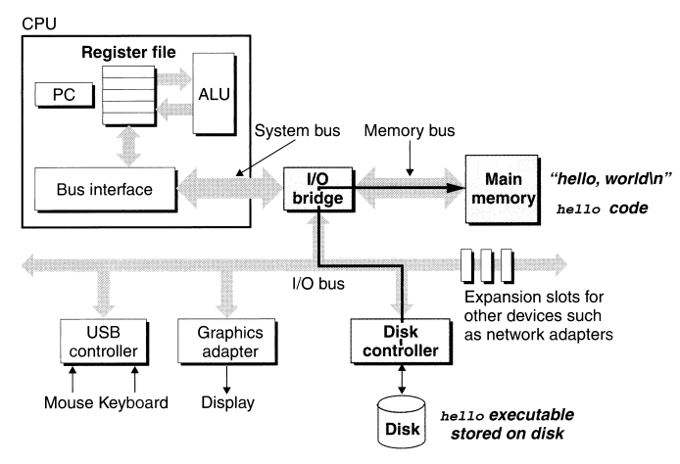
Running the “Hello World” Program
Source: Bryant & O’Hallaron

Slide 16
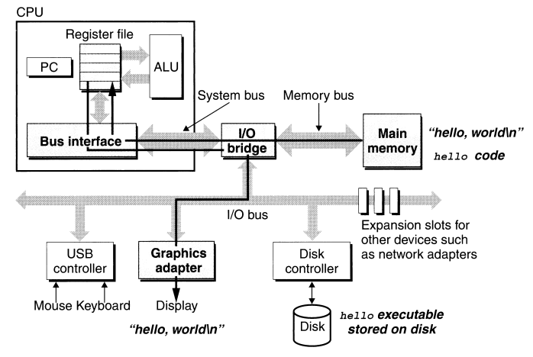
Running the “Hello World” Program
Source: Bryant & O’Hallaron

Slide 17
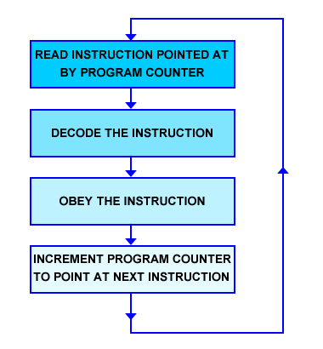
Basic Processor Model

Slide 18
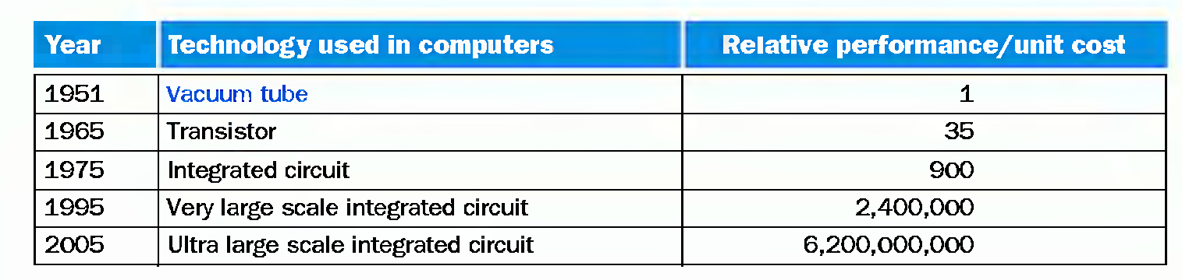
Technologies for Building Processors and Memories
A transistor is simply an on/off switch controlled by electricity.
Source: H&P-3 (Hennesy & Patterson, 3rd Edition)

Slide 19
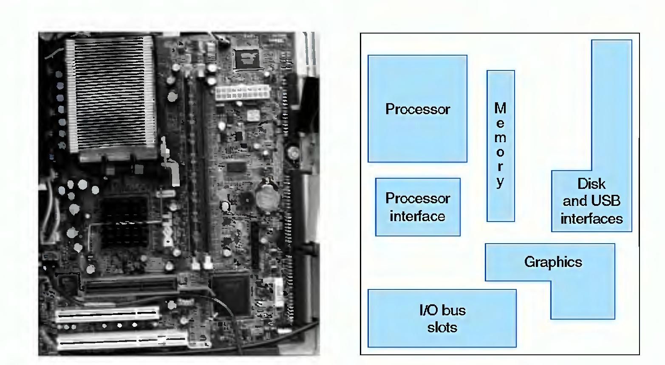
Close-up of Motherboard
Source: H&P-3 (Hennesy &
Patterson, 3rd Edition)

Slide 20
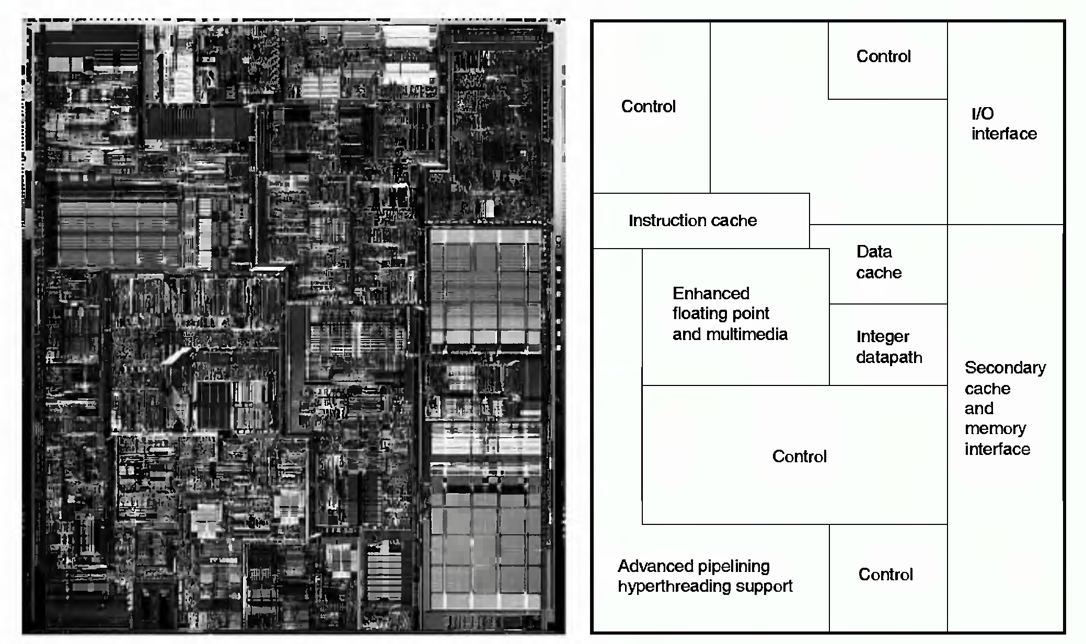
Inside a Pentium 4 Processor
Source: H&P-3 (Hennesy &
Patterson, 3rd Edition)

Slide 21
Thank You!

